Slide 1
Lecture 16alt
Analog Circuit Test
(Alternative to Lectures 17, 18, 19 and 30)
Analog circuits
Analog circuit test methods
  Specification-based testing
    Direct measurement
    DSP-based testing
  Fault model based testing
  IEEE 1149.4 analog test bus standard
Summary
References

Slide 2
Analog Circuits
Operational amplifier (analog)
Programmable gain amplifier (mixed-signal)
Filters, active and passive (analog)
Comparator (mixed-signal)
Voltage regulator (analog or mixed-signal)
Analog mixer (analog)
Analog switches (analog)
Analog to digital converter (mixed-signal)
Digital to analog converter (mixed-signal)
Phase locked loop (PLL) (mixed-signal)

Slide 3
Test Parameters
DC
    Continuity
    Leakage current
    Reference voltage
    Impedance
    Gain
    Power supply – sensitivity, common mode rejection
AC
    Gain – frequency and phase response
    Distortion – harmonic, intermodulation, nonlinearity, crosstalk
    Noise – SNR, noise figure

Slide 4
Analog Test (Traditional)
DC
~
Filter
RMS
Analog device
under test
(DUT)
PEAK
DC
ETC.
ETC.
Stimulus
Response

Slide 5
DSP-Based Mixed-Signal Test
Synthesizer
Digitizer
RAM
D/A
Analog
Analog
A/D
RAM
Mixed-signal
device under
test (DUT)
Send
memory
Receive
memory
Digital
Digital
Synchronization
Digital signal processor (DSP)
Vectors
Vectors
M. Mahoney, DSP-Based Testing of Analog and Mixed-Signal Circuits, Los Alamitos,
California: IEEE Computer Society Press, 1987, pp. 1-14.

Slide 6
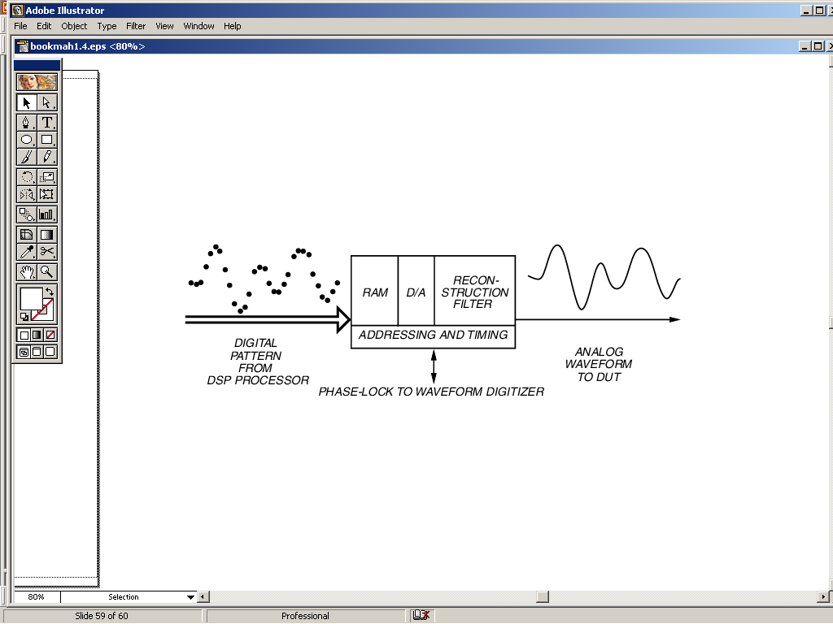
Waveform Synthesizer
© 1987 IEEE

Slide 7
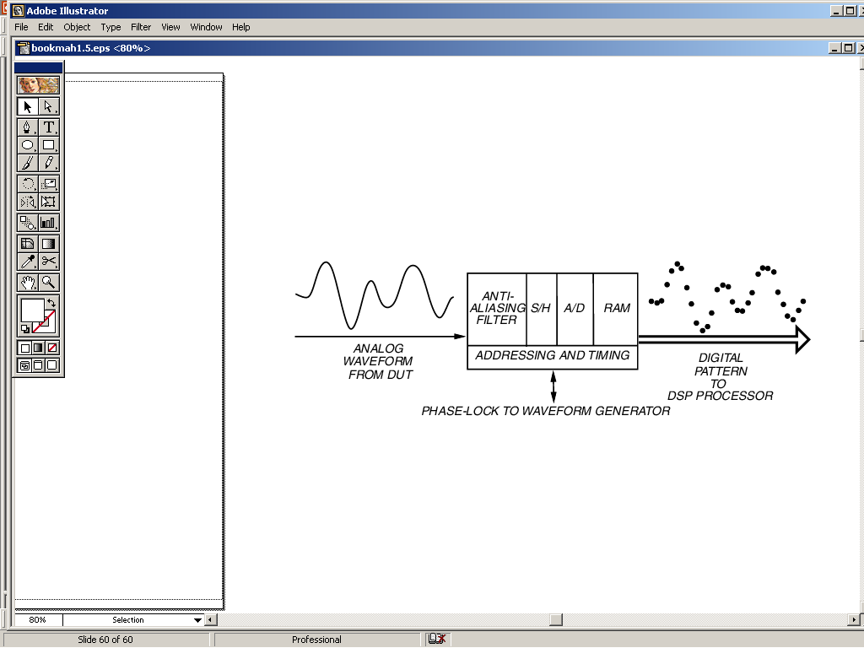
Waveform Digitizer
© 1987 IEEE

Slide 8
Example: Circuit Specification
Key Performance Specifications: TLC7524C 8-bit Multiplying Digital-to-Analog Converter
Resolution | 8 Bits
Linearity error | ½ LSB Max
Power dissipation at V_{DD} = 5 V | 5 mW Max
Settling time | 100 ns Max
Propagation delay time | 80 ns Max
M. Burns and G. W. Roberts, An Introduction to Mixed-Signal IC Test and Measurement,
New York: Oxford University Press, 2001, pp. 23-44.

Slide 9
Voltage Mode Operation
R
R
R
V_{O}
Analog
Output
Voltage
R_{FB}
2R
2R
2R
2R
2R
R
Fixed
Input
Voltage
0
1
0
1
0
1
0
1
V_{I}
OUT1
OUT2
CS
Data Latches
GND
WR
V_{O} = V_{I} (D/256)
VDD = 5 V
OUT1 = 2.5 V
OUT2 = GND
DB7
(MSB)
DB6
DB5
DB0
(LSB)
Digital data Input

Slide 10
Operational/Timing Spec.
Parameter | Test conditions | For VDD = 5 V
Linearity error |  | ±0.5 LSB
Gain error | Measured using the internal feedback resistor. Normal full scale range (FSR) = Vref – 1 LSB | ±2.5 LSB
Settling time to ½ LSB | OUT1 load = 100 Ω, Cext = 13 pF, etc. | 100 ns
Prop. Delay, digital input to 90% final output current |  | 80 ns
t_{su}(CS) ≥ 40 ns
t_{h}(CS) ≥ 0 ns
CS
t_{w}(WR) ≥ 40 ns
WR
t_{su}(D) ≥ 25 ns
t_{h}(D) ≥ 10 ns
DB0-DB7

Slide 11
Operating Range Spec.
Supply voltage, V_{DD} | -0.3 V to 16.5 V
Digital input voltage range | -0.3 V to V_{DD}+0.3 V
Reference voltage, V_{ref} | ±25 V
Peak digital input current | 10μA
Operating temperature | -25ºC to 85ºC
Storage temperature | -65ºC to 150ºC
Case temperature for 10 s | 260ºC

Slide 12
Test Plan: Hardware Setup
+Full-scale code
D7-D0
DACOUT
V_{o}
V_{I}
+
V_{out}
-
R_{LOAD}
1 kΩ
VM
+
-
2.5 V

Slide 13
Test Program Pseudocode
dac_full_scale_voltage()
{
set VI1 = 2.5 V; /* Set the DAC voltage reference to 2.5 V */
start digital pattern = “dac_full_scale”; /* Set DAC output to
+full scale (2.5 V) */
connect meter: DAC_OUT /* Connect voltmeter to DAC output */
fsout = read_meter(), /* Read voltage level at DAC_OUT pin */
test fsout; /* Compare the DAC full scale output to data sheet limit */
}

Slide 14
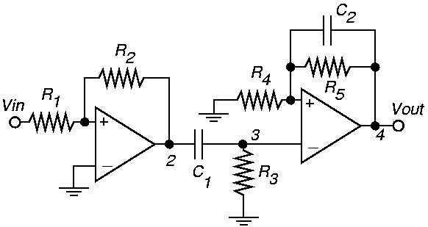
Analog Fault Models
Low-pass
filter
amplifier
Op Amp
High-pass
filter
A₁ First stage gain R₂ / R₁
A₂ High-pass filter gain R₃ and C₁
f_{C1} High-pass filter cutoff frequency C₁
A₃ Low-pass AC voltage gain R₄, R₅ and C₂
A₄ Low-pass DC voltage gain R₄ and R₅
f_{C2} Low-pass filter cutoff frequency C₂

Slide 15
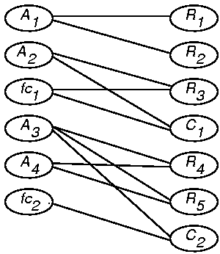
Bipartite Graph of Circuit
Minimum set of
parameters to
be observed

Slide 16
Method of ATPG Using Sensitivities
Compute analog circuit sensitivities
Construct analog circuit bipartite graph
From graph, find which output parameters (performances) to measure to guarantee maximal coverage of parametric faults
  Determine which output parameters are most sensitive to faults
Evaluate test quality, add test points to complete the analog fault coverage
N. B. Hamida and B. Kaminska, “Analog Circuit Testing Based on Sensitivity Computation and New Circuit Modeling,” Proc. ITC, 1993.

Slide 17
Sensitivity
Differential (small element variation):
S = × =
Incremental (large element variation):
ρ = ×
T_{j} – performance parameter
x_{i} – network element
T_{j}
x_{i} ∂T_{j}
T_{j} ∂x_{i}
ΔT_{j} / T_{j}
Δx_{i} / x_{i}
x_{i}
Δ x_{i} → 0
T_{j}
x_{i}
T_{j}
ΔT_{j}
Δx_{i}
x_{i}

Slide 18
Incremental Sensitivity Matrix of Circuit
-0.91
0
0
0
0
0
R₁
1
0
0
0
0
0
R₂
0
0.58
-0.91
0
0
0
C₁
0
0.38
-0.89
0
0
0
R₃
0
0
0
-0.96
-0.97
0
R₄
0
0
0
0.48
-0.97
-0.88
R₅
0
0
0
-0.48
0
-0.91
C₂
A₁
A₂
fc₁
A₃
A₄
fc₂

Slide 19
Tolerance Box: Single-Parameter Variation
5% ≤ ≤ 14.81%
5% ≤ ≤ 15.20%
5% ≤ ≤ 14.65%
5% ≤ ≤ 13.96%
5% ≤ ≤ 15.00%
5% ≤ ≤ 35.00%
5% ≤ ≤ 35.00%
ΔR₁
R₁
ΔR₂
R₂
ΔR₃
R₃
ΔC₁
C₁
ΔR₄
R₄
ΔR₅
R₅
ΔR₃
R₃
ΔC₁
C₁
ΔR₅
R₅
ΔC₂
C₂
ΔR₄
R₄
ΔR₅
R₅
ΔC₂
C₂
5% ≤ ≤ 15.98%
5% ≤ ≤ 14.10%
5% ≤ ≤ 20.27%
5% ≤ ≤ 11.60%
5% ≤ ≤ 15.00%
5% ≤ ≤ 15.00%
f_{C1}
f_{C2}
A₃
A₁
A₂
A₄

Slide 20
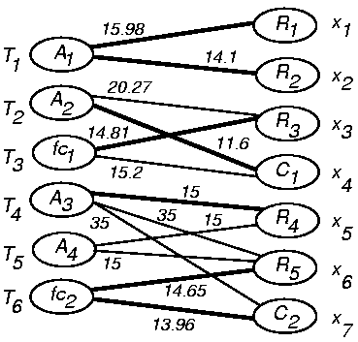
Weighted Bipartite Graph
Five tests
provide most
sensitive
measurement
of all components

Slide 21
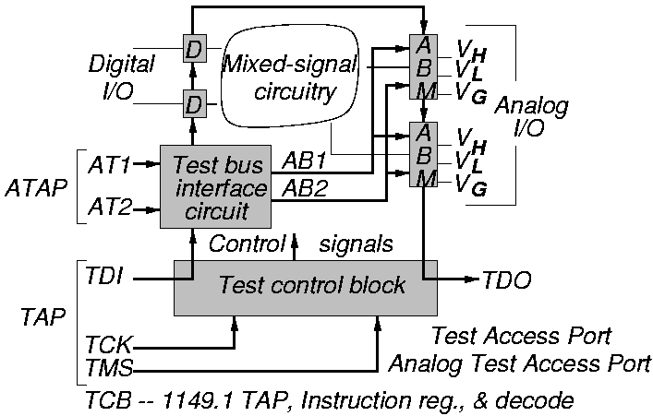
IEEE 1149.4 Standard
Analog Test Bus (ATB)

Slide 22
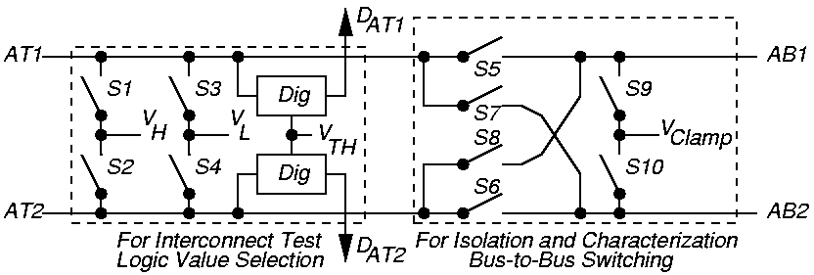
Test Bus Interface Circuit (TBIC)

Slide 23
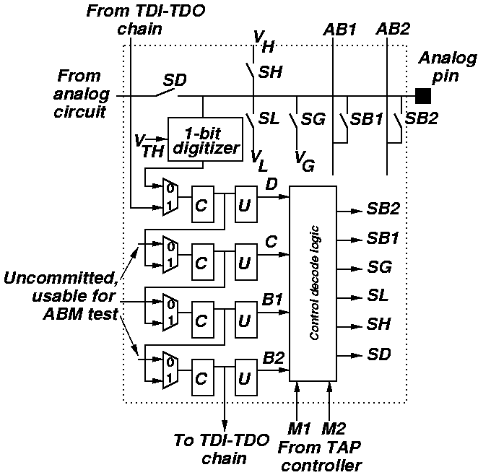
Analog Boundary Module (ABM)

Slide 24
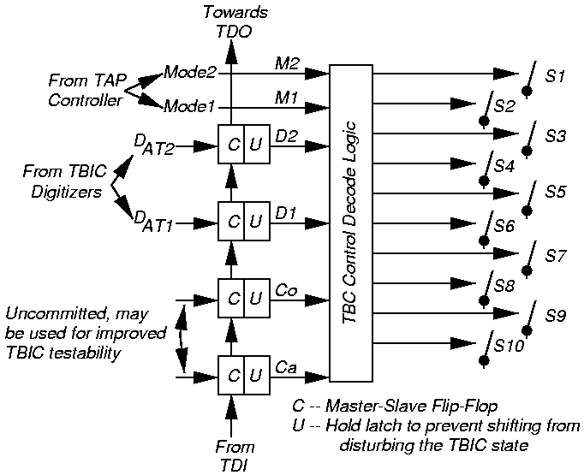
TBIC Switch Controls

Slide 25
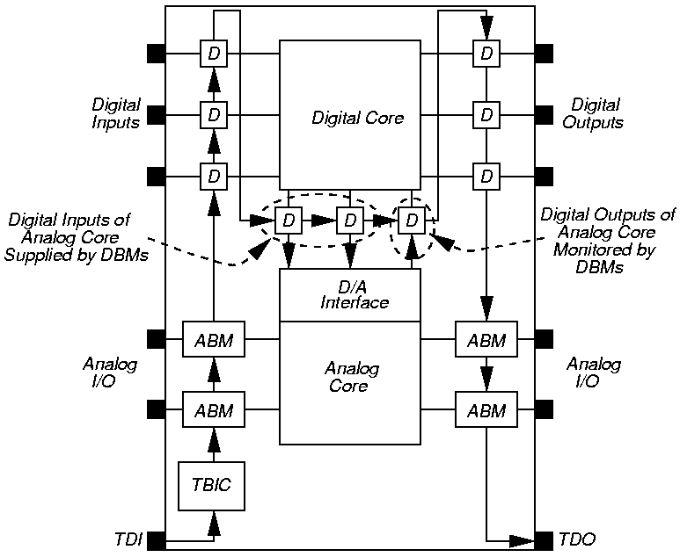
Digital/Analog Interfaces
At any time, only 1 analog pin can be stimulated and only 1 analog pin can be read

Slide 26
Summary
DSP-based tester has:
  Waveform synthesizer
  Waveform digitizer
  High frequency clock with dividers for synchronization
Analog test methods
  Specification-based functional testing
  Model-based analog testing
Analog test bus allows static analog tests of mixed-signal devices
  Boundary scan is a prerequisite

Slide 27
References: Analog & RF Test
A. Afshar, Principles of Semiconductor Network Testing, Boston: Butterworth-Heinemann, 1995.
M. Burns and G. Roberts, Introduction to Mixed-Signal IC Test and Measurement, New York: Oxford University Press, 2000.
M. L. Bushnell and V. D. Agrawal, Essentials of Electronic Testing for Digital, Memory and Mixed-Signal VLSI Circuits, Boston: Springer, 2000. Chapters 10, 11 and 17.
D. Gizopoulos, editor, Advances in Electronic Testing Challenges and Methodologies, Springer, 2006. Chapters 9 and 10.
J. L. Huertas, editor, Test and Design-for-Testability in Mixed-Signal Integrated Circuits, Boston: Springer, 2004.
P. Kabisatpathy, A Barua, and S. Sinha, Fault Diagnosis of Analog Integrated Circuits, Springer, 2005.
R. W. Liu, editor, Testing and Diagnosis of Analog Circuits and Systems, New York: Van Nostrand Reinhold, 1991.
M. Mahoney, DSP-Based Testing of Analog and Mixed-Signal Circuits, Los Alamitos, California: IEEE Computer Society Press, 1987.
A. Osseiran, Analog and Mixed-Signal Boundary Scan, Boston: Springer, 1999.
T. Ozawa, editor, Analog Methods for Computer-Aided Circuit Analysis and Diagnosis, New York: Marcel Dekker, 1988.
K. B. Schaub and J. Kelly, Production Testing of RF and System-on-a-Chip Devices for Wireless Communications, Boston: Artech House, 2004.
B. Vinnakota, editor, Analog and Mixed-Signal Test, Upper Saddle River, New Jersey: Prentice-Hall PTR, 1998.

